Slide 1
CAMPUS NAVIGATION SYSTEM
Group Members: Van Thuan tran
Rajiv Gautam
sisir Khadka
asmin kandel

Slide 2

Project Overview
Interactive campus route-finding application
Works like a mini-Google Maps for campus
Users select start and end buildings
System calculates shortest path
Path highlighted visually on the map

Slide 3
Project Goals
Build
Build a weighted, undirected graph
Implement
Implement Dijkstra’s shortest-path algorithm
Display
Display map, nodes, and edges using JavaFX
Enable
Enable node clicking to autofill start/end fields
Show
Show total distance and estimated walking time

Slide 4
System Components
Graph.java – Adjacency list + structure
Node.java – Stores id, name, X/Y coordinates
Edge.java – Stores connection + weight
DataLoader.java – Loads CSV files (nodes + paths)
Dijkstra.java – Computes shortest path
MapCanvas.java – Draws buildings/roads in JavaFX
MainApp.java – Main UI and event handling

Slide 5
Data Structures
HashMap<String, ArrayList<Edge>> → adjacency list
PriorityQueue → picks smallest distance node
HashMap → distances, previous nodes, node coordinates
ArrayList → store edges per building
CSV files → nodes.csv + edges.csv / paths.csv

Slide 6

Algorithm
Start from selected source node
Use PriorityQueue to pick smallest distance
Update adjacent nodes’ distances
Repeat until destination is reached
Reconstruct path using “previous” map
Outputs: shortest path + total distance

Slide 7
JavaFX UI Features
BorderPane layout
Center pane displays campus map
Buildings shown as circles + labels
Edges drawn as lines with distances
Click node to set start/end building
Highlights shortest path on map

Slide 8
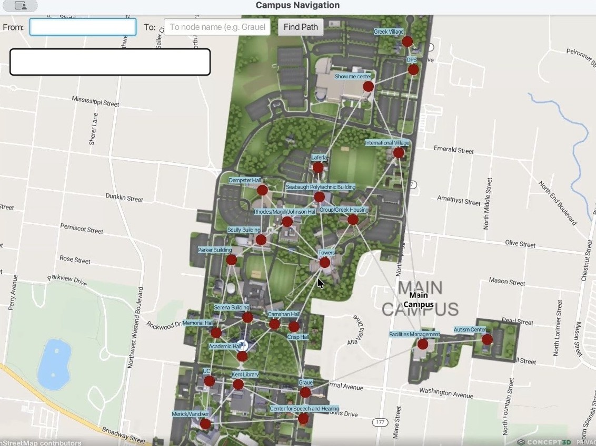
Overview of the application

Slide 9

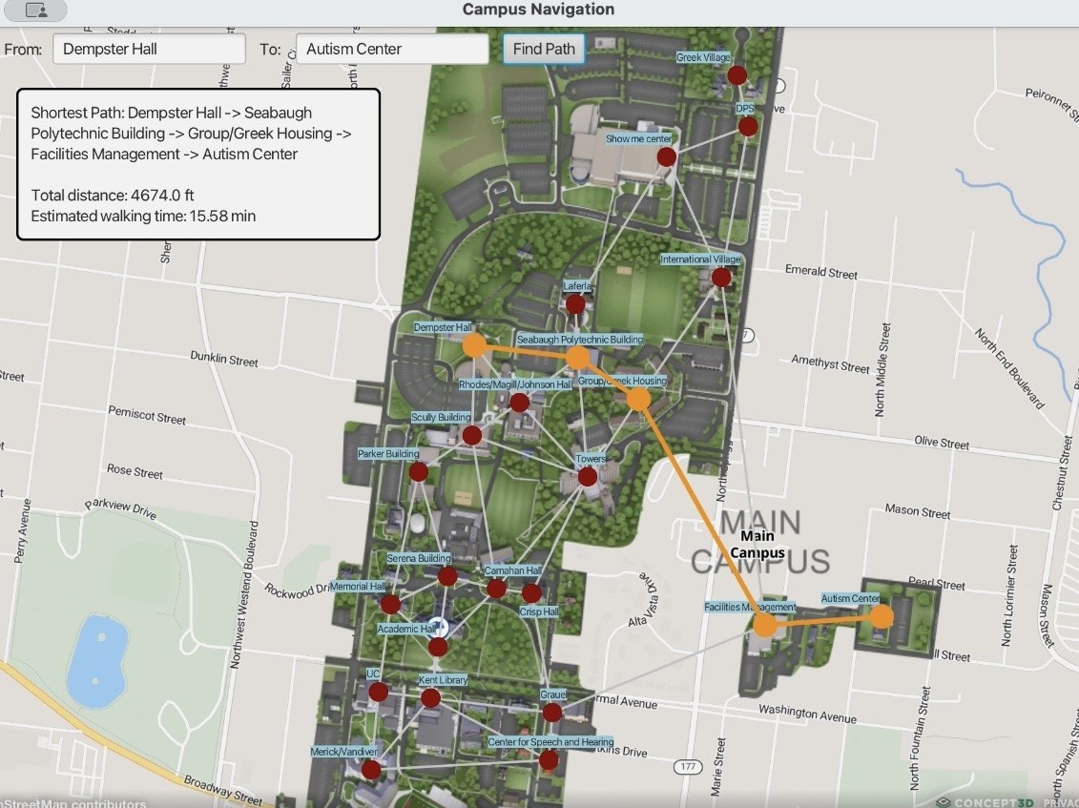
Sample Output
Dempster Hall → Seabaugh Poly → Greek Housing → Facilities Management → Autism Center
Total distance: 4674 ft
Estimated walking time: 15.58 minutes
Path highlighted in orange on map

Slide 10
How to Run
Install
Install JDK 19 + JavaFX 21
Open
Open project in IntelliJ/Eclipse/VS Code
Add
Add JavaFX SDK to project
Set
Set required VM options
Run
Run Main.java
Select
Select buildings → click “Find Path”

Slide 11
Conclusion
Learned practical applications of graph theory
Implemented Dijkstra’s algorithm from scratch
Built interactive UI with JavaFX
Gained file I/O and visualization experience
Strengthened teamwork and coding workflow

